Slide 1
Kami 3: Release 2
Zach Dubinsky, Jack Collins, Khai Dong

Slide 2
Milestones
GUI Refresh
Hint Refresh
Multiple Files
Test Doubles
Memento Pattern

Slide 3
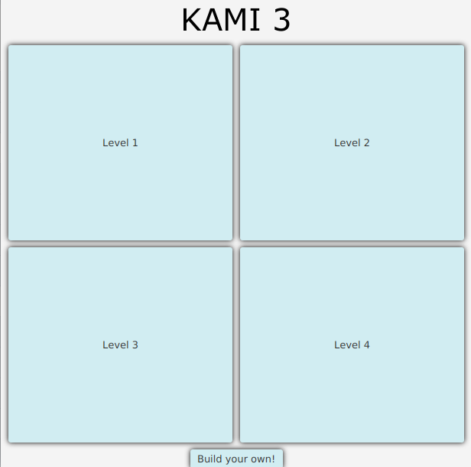
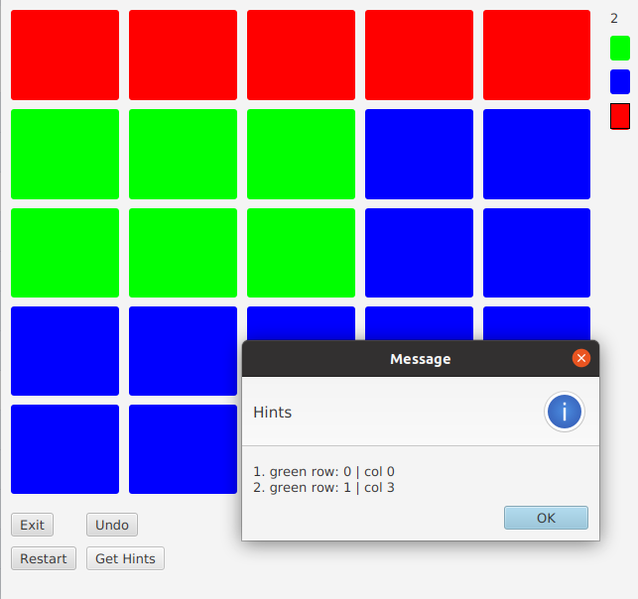
GUI Refresh
Menu
General Style
In-Window Hints

Slide 4
Hint Refresh
Heuristic Solver
Single Step Hints
Multi File Compatibility

Slide 5

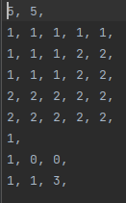

Multiple Files
New .rectgrl file!
Comma delimited
Chain of Responsibility Load

Slide 6
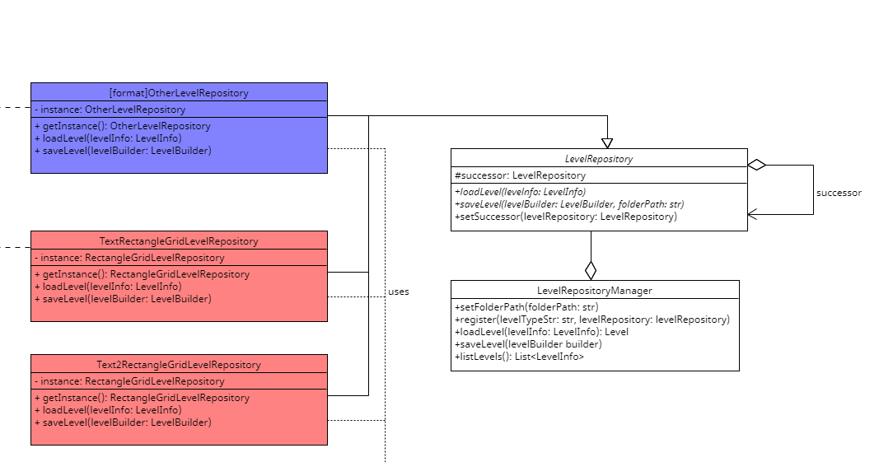
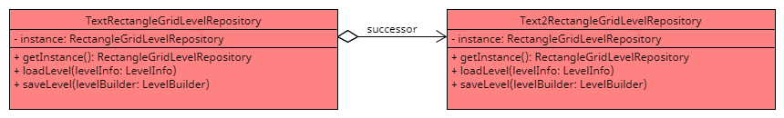

Slide 7
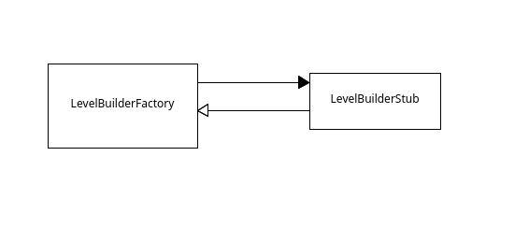
Test Doubles

Slide 8
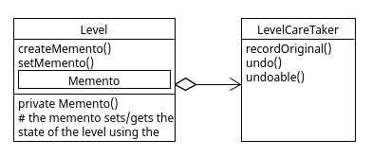
Memento Pattern

Slide 9
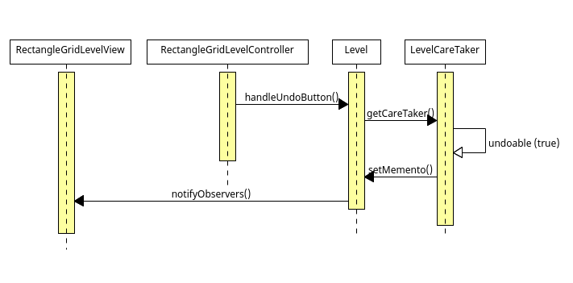
Memento Pattern

